Slide 1
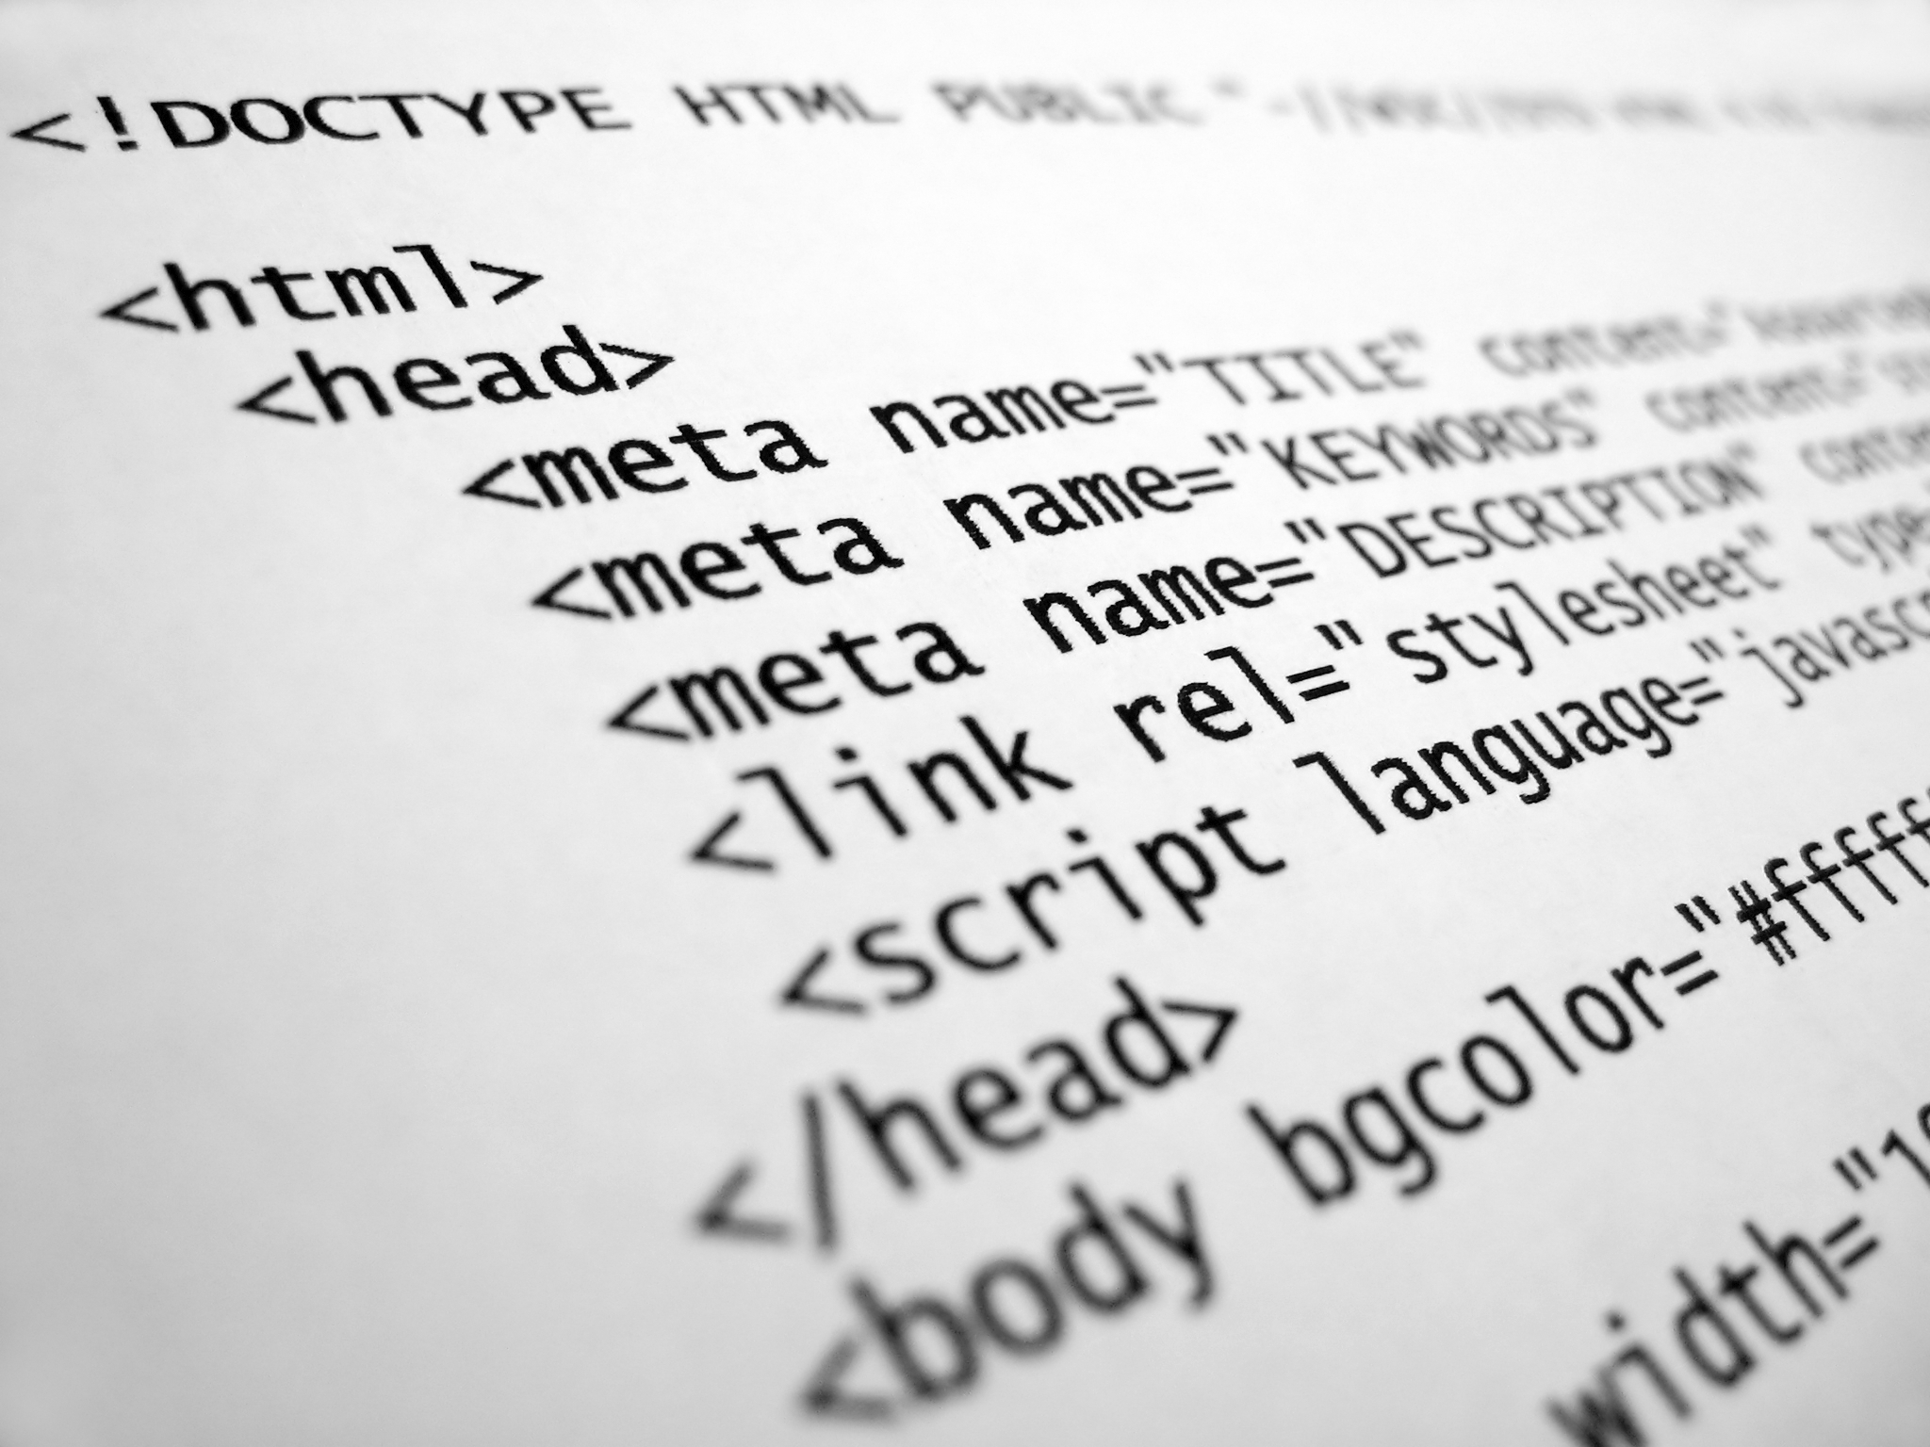
Internet Programming Labratory

Slide 2
HTML
Hypertext Markup Language is the standard markup language for creating web pages and web applications. With Cascading Style Sheets and JavaScript, it forms a triad of cornerstone technologies for the World Wide Web

Slide 3
CSS
Cascading Style Sheets is a style sheet language used for describing the presentation of a document written in a markup language like HTML. CSS is a cornerstone technology of the World Wide Web, alongside HTML and JavaScript.

Slide 4
JAVASCRIPT
JavaScript, often abbreviated as JS, is a high-level, interpreted programming language. It is a language which is also characterized as dynamic, weakly typed, prototype-based and multi-paradigm. Alongside HTML and CSS, JavaScript is one of the three core technologies of the World Wide Web.

Slide 5

Hospital Management System
A hospital management system (HMS) is a computer or web based system that facilitates managing the functioning of the hospital or any medical set up¹. This system or software will help in making the whole functioning paperless. It integrates all the information regarding patients, doctors, staff, hospital administrative details etc. into one software⁴..

Slide 6
Benefits of HMS
Achieve good quality ratings
Better revenue management
Avoid errors and track every single detail
Improved clinical decision-making
Establish your hospital as technically advanced

Slide 7
Some of our important modules!

Slide 8
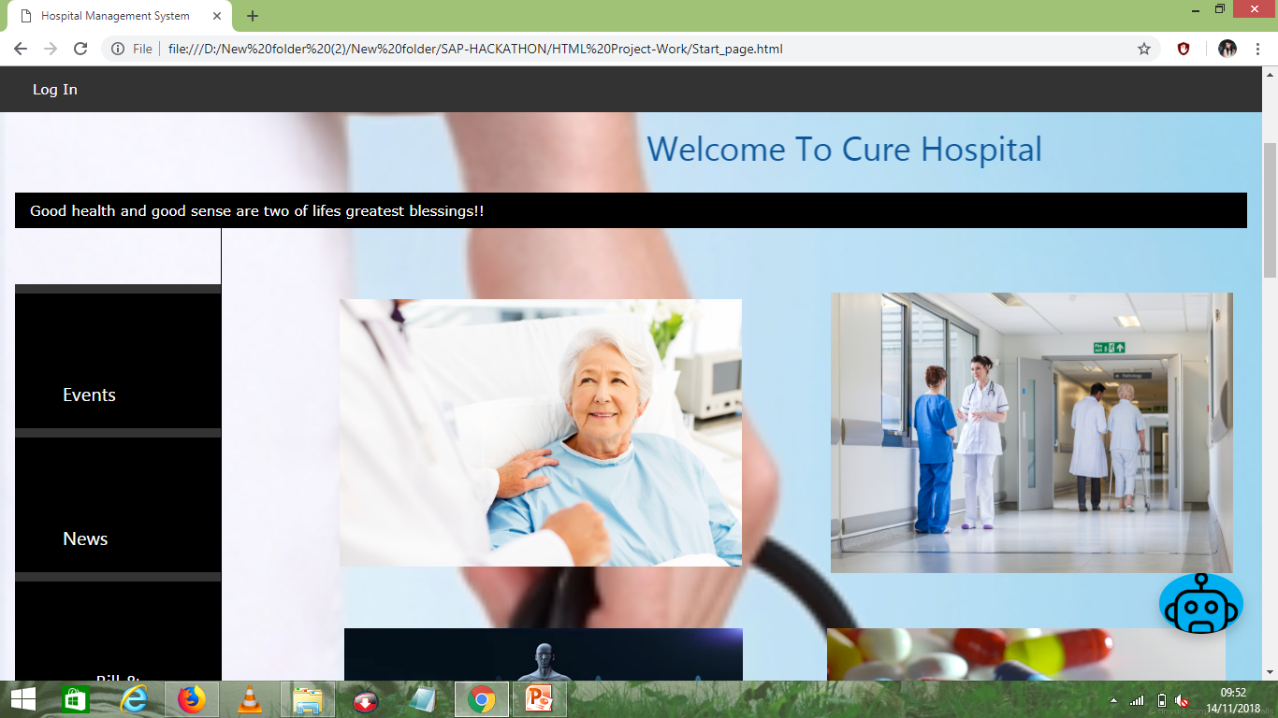
Home Page

Slide 9
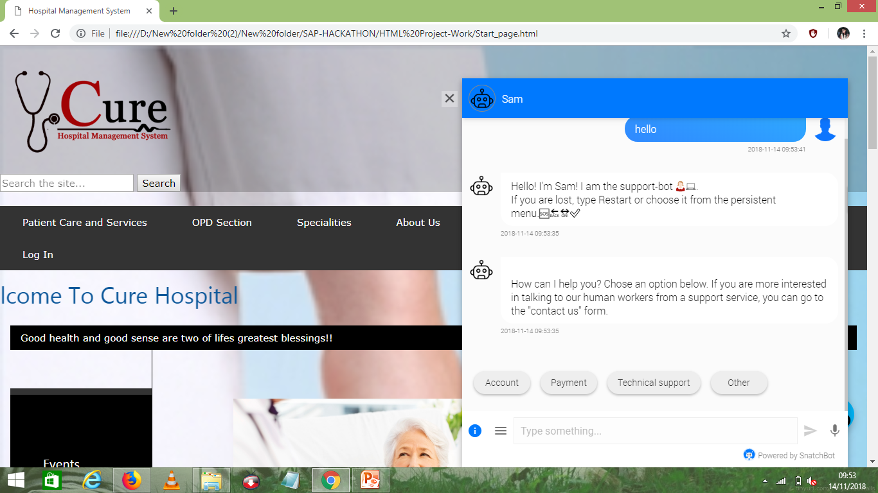
Chatbot

Slide 10
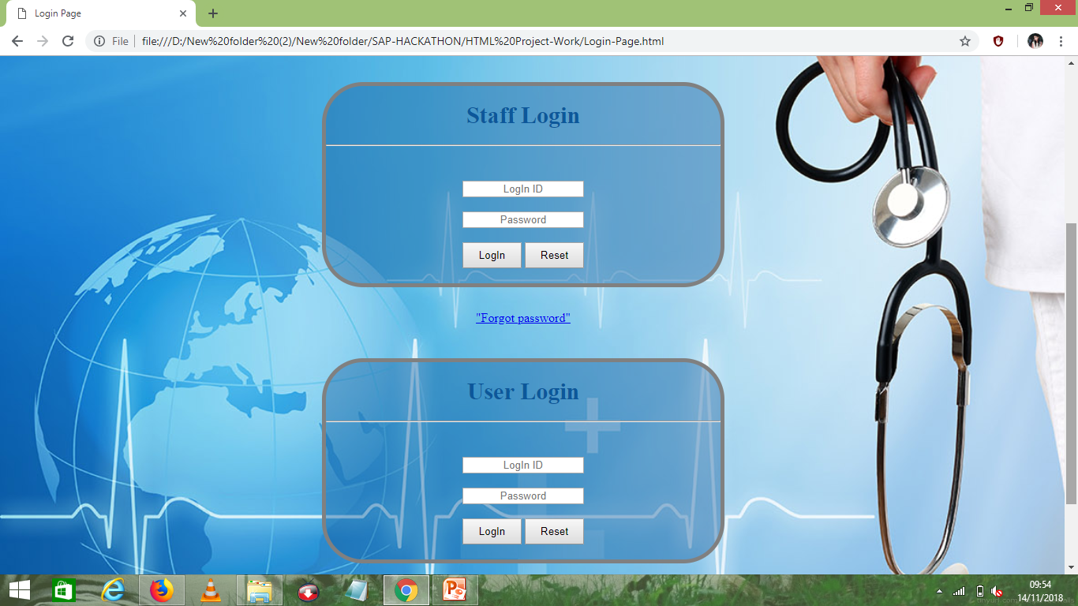
Log In module

Slide 11
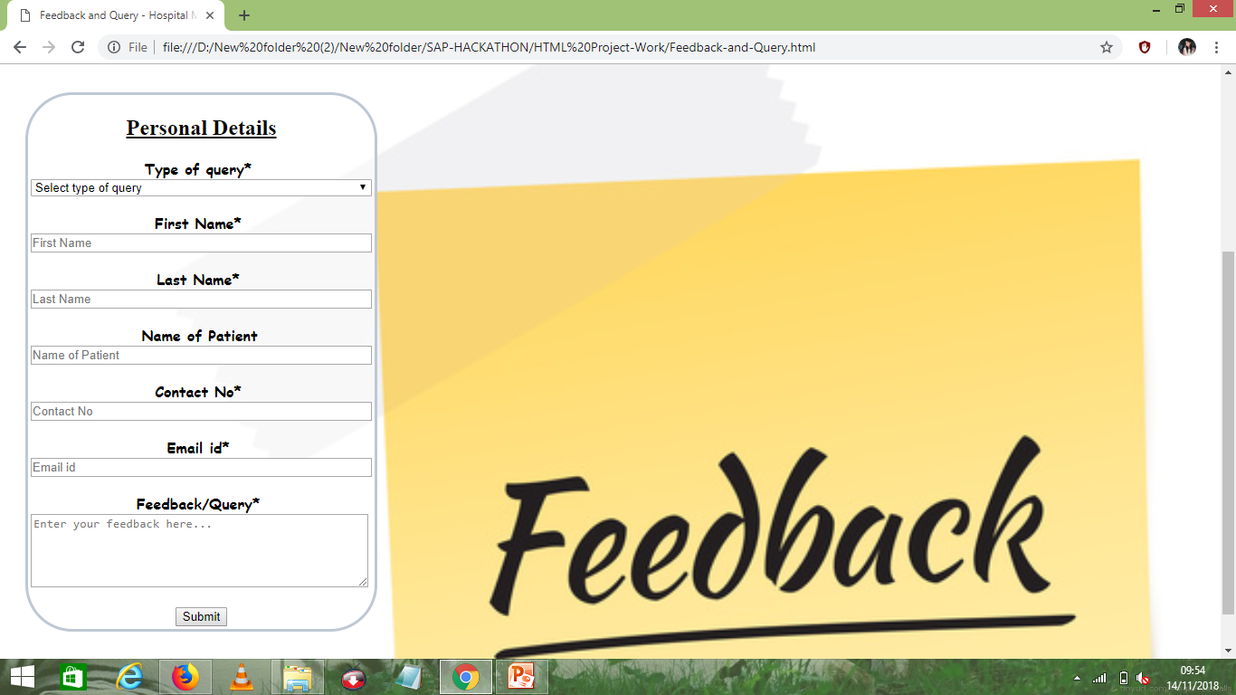
Feedback module

Slide 12
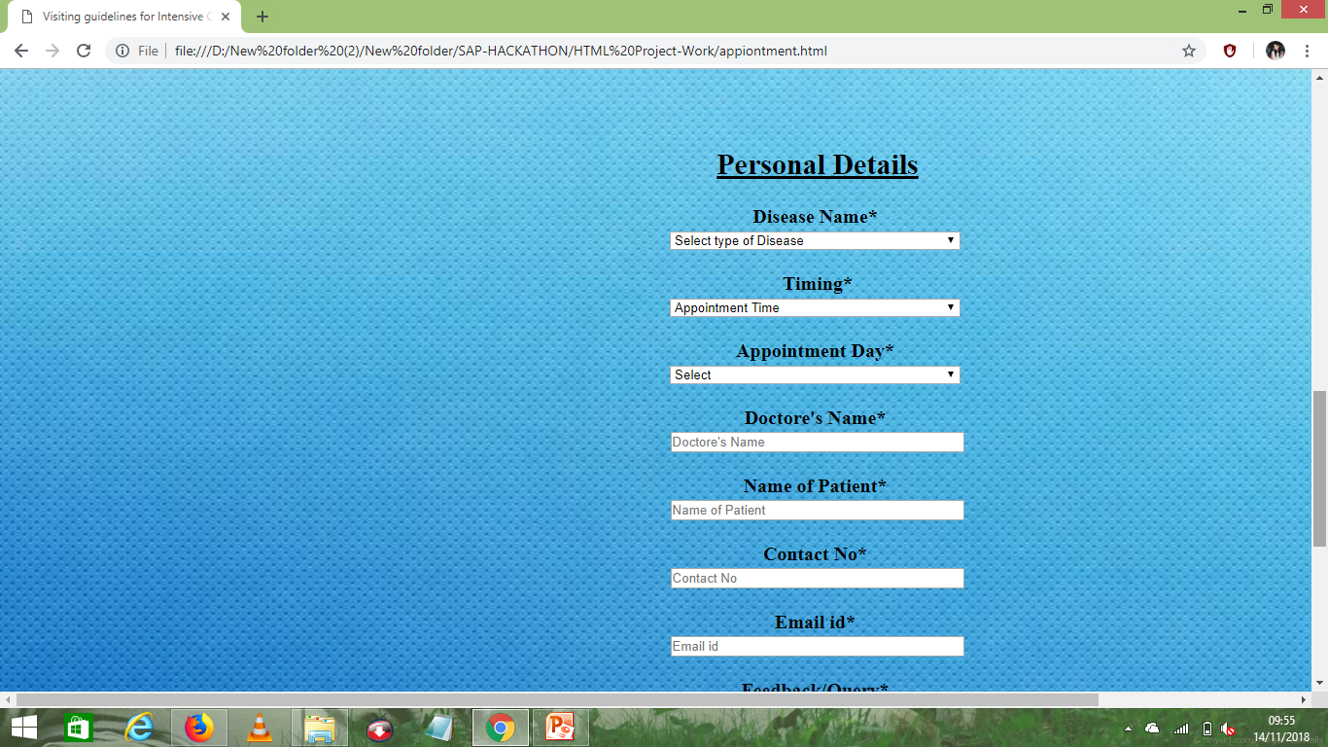
Make an appointment

Slide 13
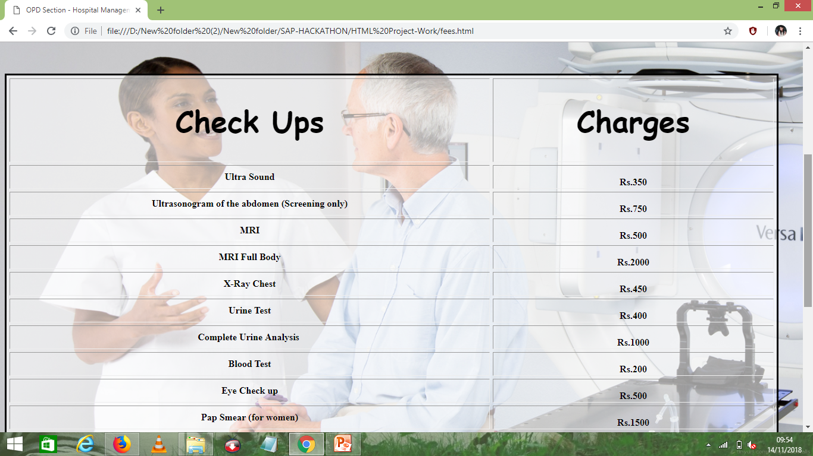
Fees and Charges

Slide 14
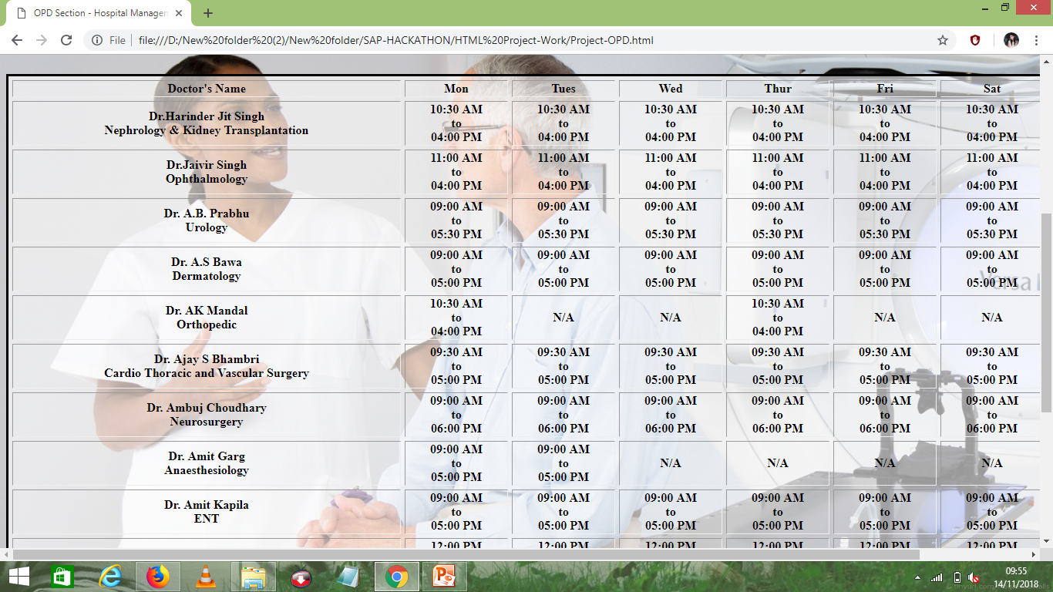
Timings

Slide 15
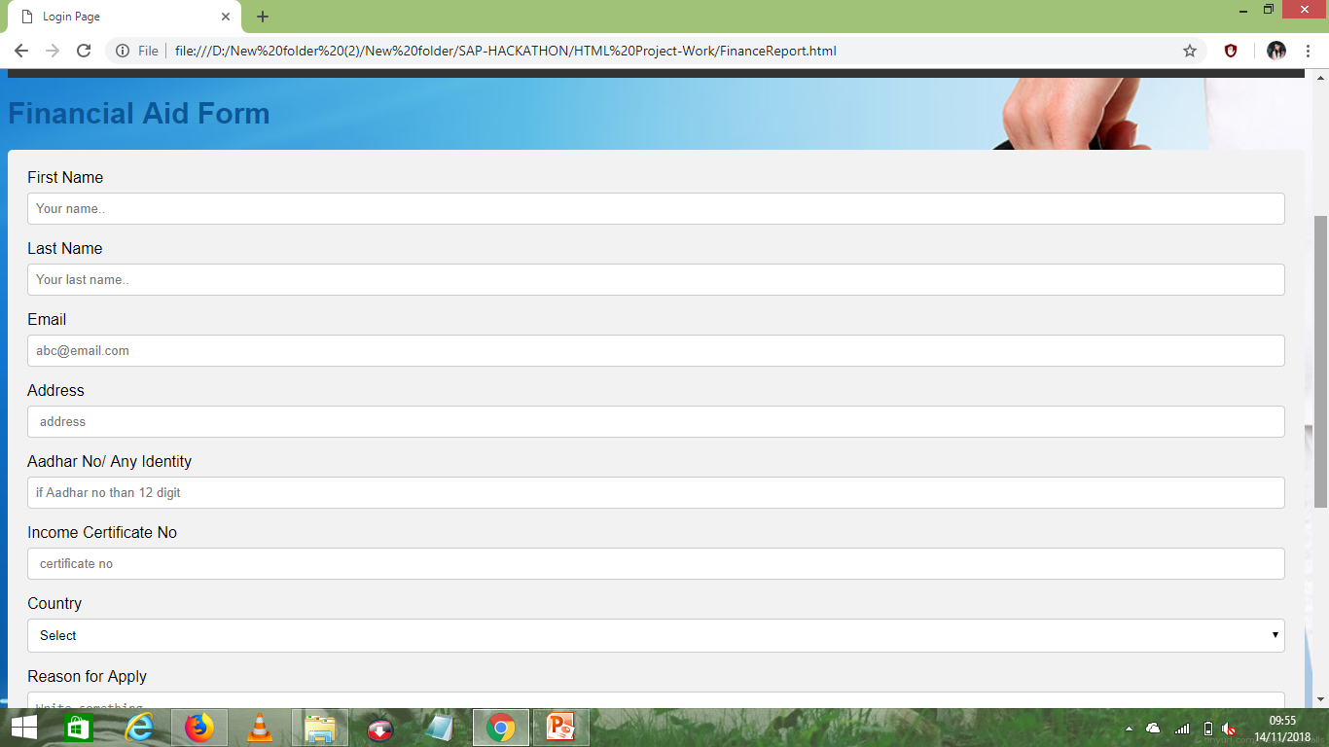
Financial Aid

Slide 16
Unique points of HMS
Fees transperancy
Timings available
User login
Bill Information
Financial Aid

Slide 17


